Slide 1
GitHub Copilot on JetBrains PhpStorm
Presented By
John Dohoney, Sr.CSA
CSU SDP-West

Slide 2
Agenda
Prompting Lab
PHPStorm Installation
PHP Labs
Date Difference Lab
Unit Test Lab

Slide 3
Prompting – Best Practices
Set the stage with a High-Level Goal
This is most helpful if you have a blank file or empty codebase. In other words, if GitHub Copilot has zero context of what you want to build or accomplish, setting the stage for the AI pair programmer can be really useful. It helps to prime GitHub Copilot with a big picture description of what you want it to generate—before you jump in with the details.
When prompting GitHub Copilot, think of the process as having a conversation with someone: How should I break down the problem so we can solve it together? How would I approach pair programming with this person?

Slide 4
Prompting – Best Practices
Make your ask simple and specific. Aim to receive short output from GitHub Copilot
Once you communicate your main goal to the AI pair programmer, articulate the logic and steps it needs to follow for achieving that goal. GitHub Copilot better understands your goal when you break things down.
(Imagine you’re writing a recipe. You’d break the cooking process down into discrete steps–not write a paragraph describing the dish you want to make.)
Let GitHub Copilot generate the code after each step, rather than asking it to generate a bunch of code all at once.

Slide 5
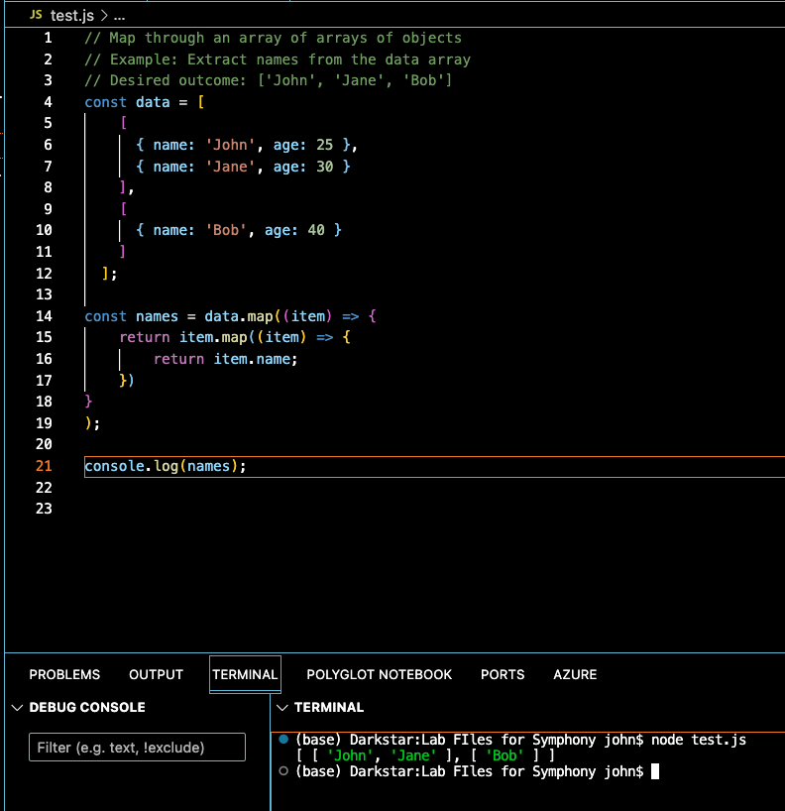
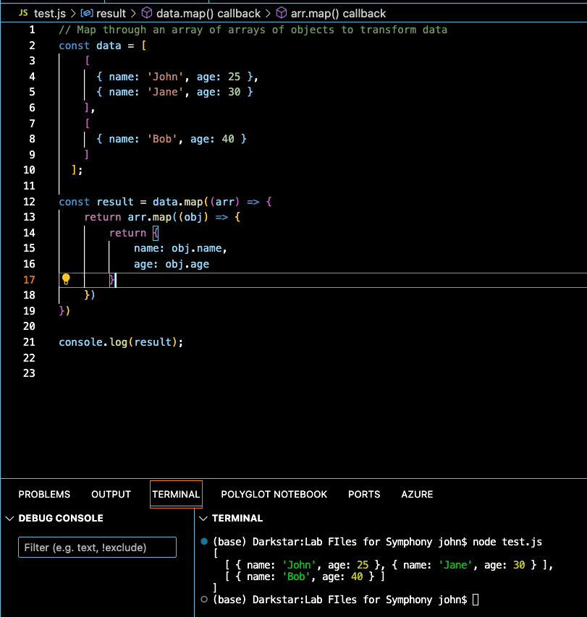
Prompting – Best Practices
Give GitHub Copilot an example or two
Learning from examples is not only useful for humans, but also for your AI pair programmer.

Slide 6
Prompting – Basics
Experiment with your prompts.
Just how conversation is more of an art than a science, so is prompt crafting. So, if you don’t receive what you want on the first try, recraft your prompt by following the best practices in the previous slides.
Keep a couple of relevant tabs open
No exact number of tabs is documented that you should keep open to help GitHub Copilot contextualize your code, but from my experience, I found that one or two is helpful.
GitHub Copilot uses a technique called neighboring tabs that allows the AI pair programmer to contextualize your code by processing all of the files open in your IDE instead of just the single file you’re working on. However, it’s not guaranteed that Github Copilot will deem all open files as necessary context for your code.
Use good coding practices.
Provide descriptive variable names and functions. Follow consistent coding styles and patterns. I’ve found that working with GitHub Copilot encourages me to follow good coding practices learned throughout my development career.

Slide 7

DALL-E Lab

Slide 8
Prompting Exercise – With Dall-E
What is DALL-E
DALL-E is an image generation model developed by OpenAI that can generate unique images from textual descriptions
Odd Name?
DALLE stands for “DAll-E”, which is a combination of the words “Dali” and “Wall-E”. The name is a nod to surrealist artist Salvador Dali and the Pixar movie character Wall-E, and reflects the combination of language and image processing capabilities of the model.
How does it work?
DALL-E uses a transformer-based neural network architecture that combines both language and image processing techniques. It generates images by decomposing the textual description into a set of image features, which are then used to generate the final image.

Slide 9

Prompting Exercise – Instructions
Go To: https://www.bing.com/images/create
The Idea is to try your hand at prompting and evolve your design with added specificity to your prompts.
My Example:
Prompt: “pencil drawing of a remote island on a sunny day”

Slide 10

Prompting Exercise – Instructions
Now, evolve your drawing:
Prompt: pencil drawing of a remote island on a sunny day with sharks swimming around the island
Notice the Hallucination… (Do sharks Fly? )

Slide 11

Prompting Exercise – Instructions
Further evolve your drawing:
Pretend you are Escher. pencil drawing of a remote island on a sunny day with sharks swimming around the island in the water
I did not get recursion, but I did get reflection – pretty cool

Slide 12

Prompting Exercise – Conclusions
What can we conclude from this exercise?
How did prompting change your images?
How do you think this will work with code generation?
pretend you are Escher. watercolor of a remote island on a sunny day with sharks swimming around the island in the water

Slide 13

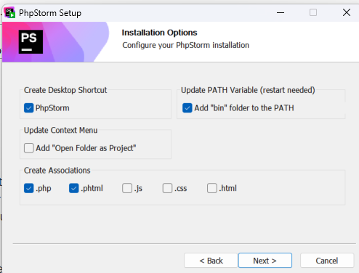
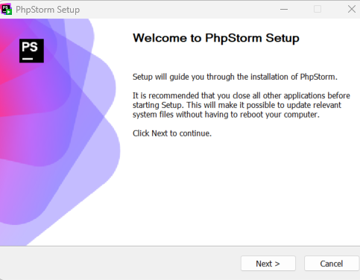
Download PhpStorm
PhpStorm: The PHP IDE by JetBrains

Slide 14
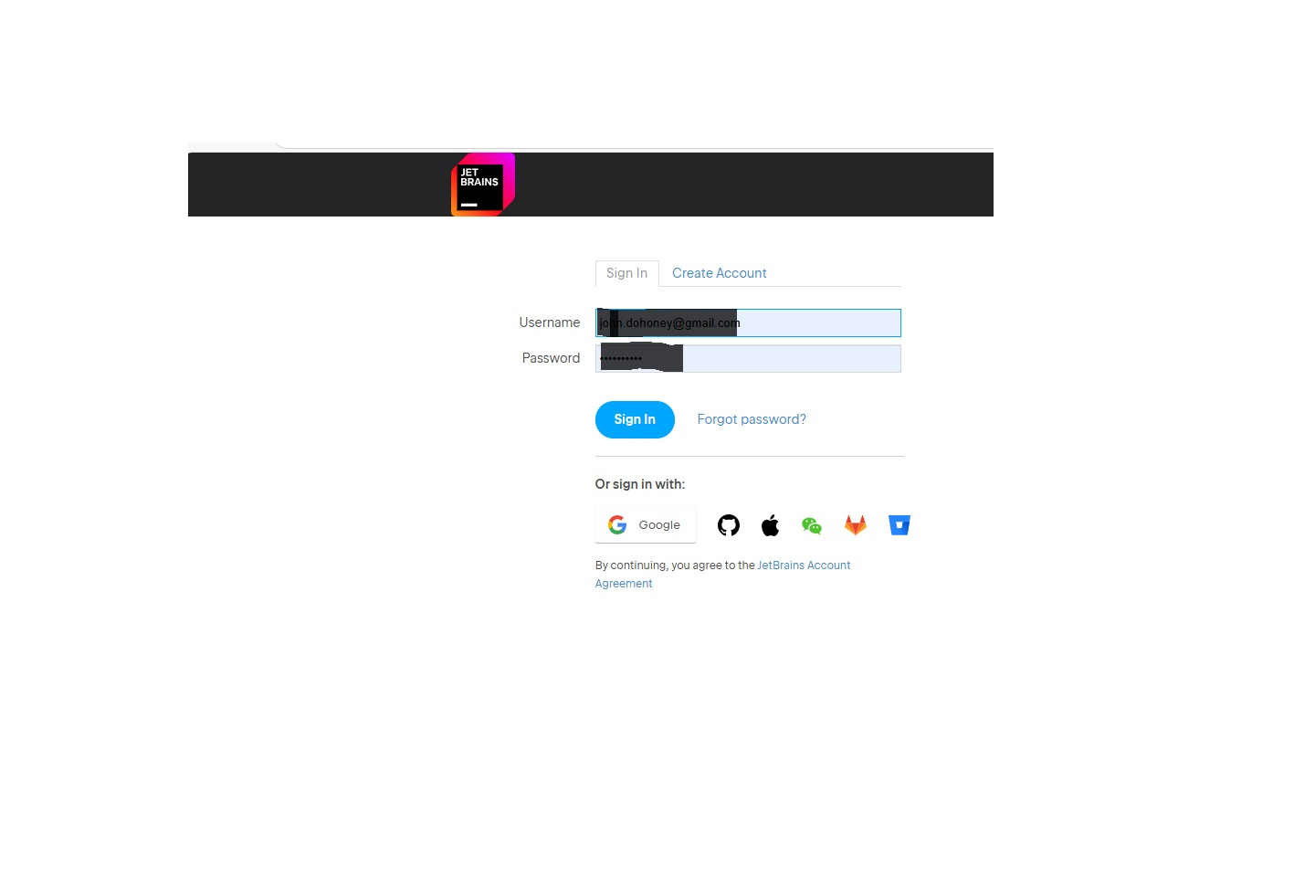
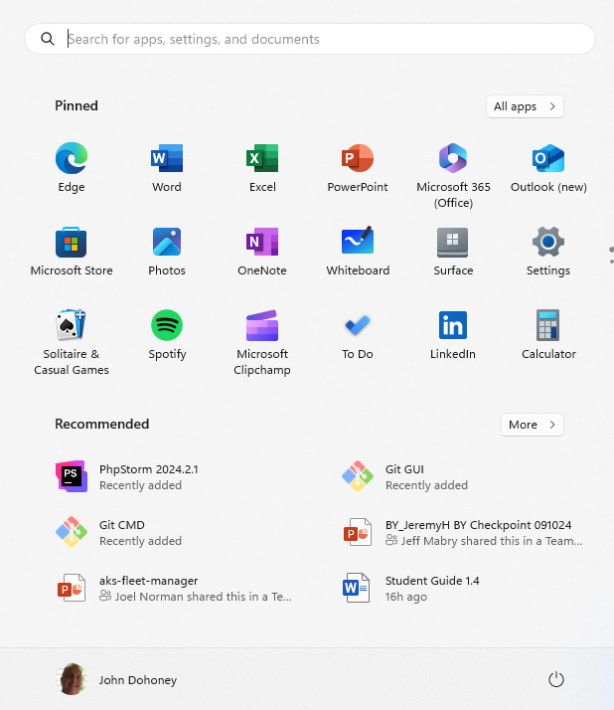
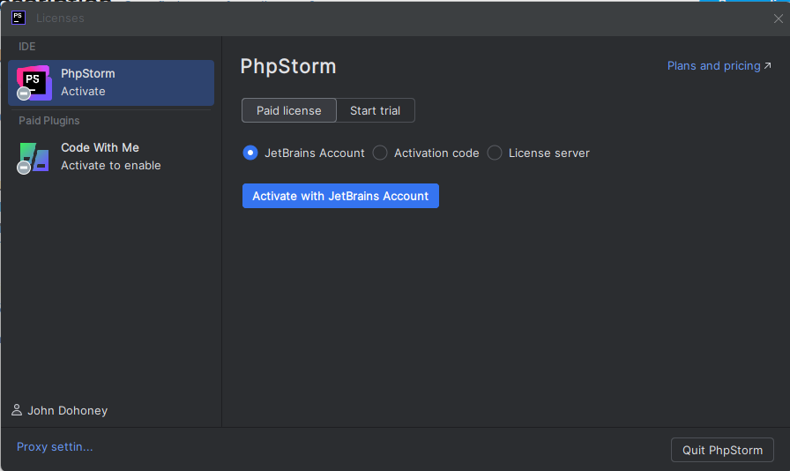
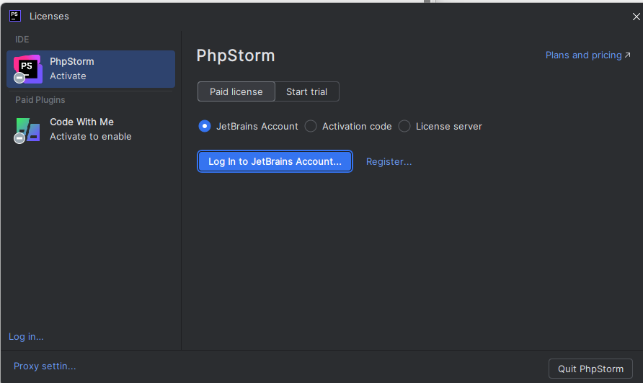
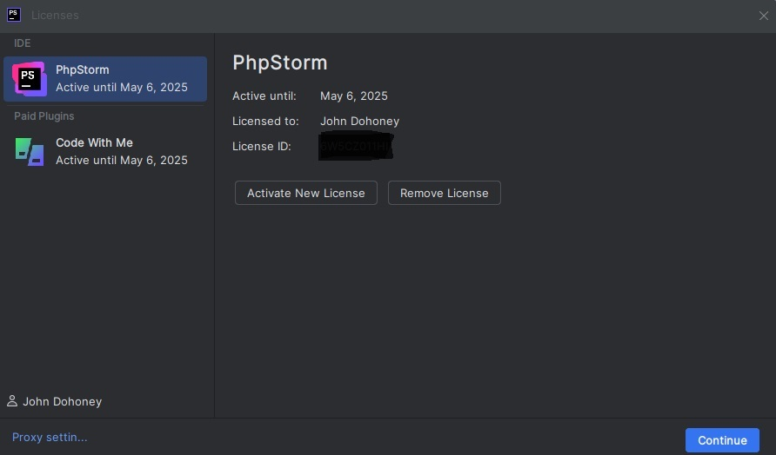
License Activation

Slide 15
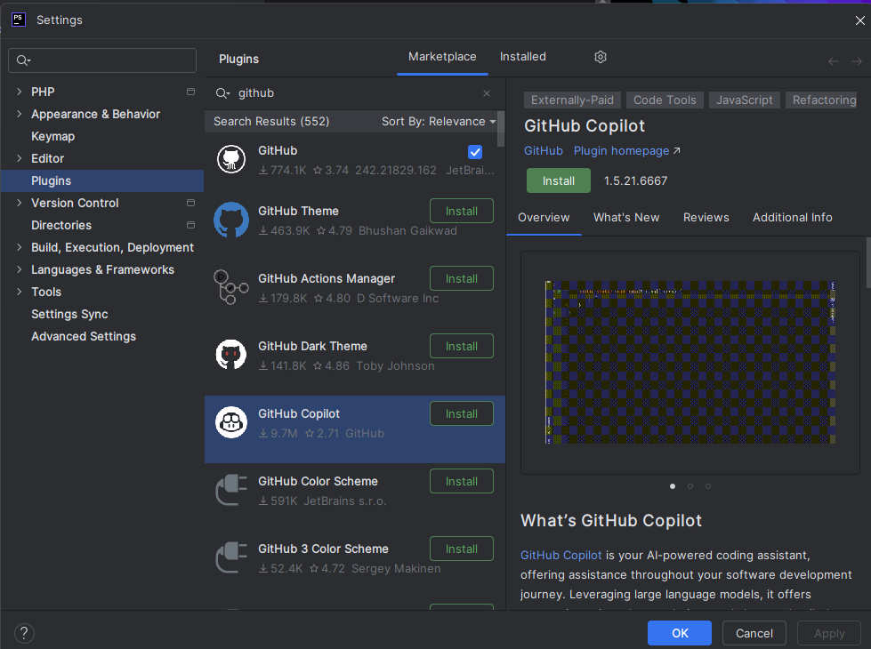
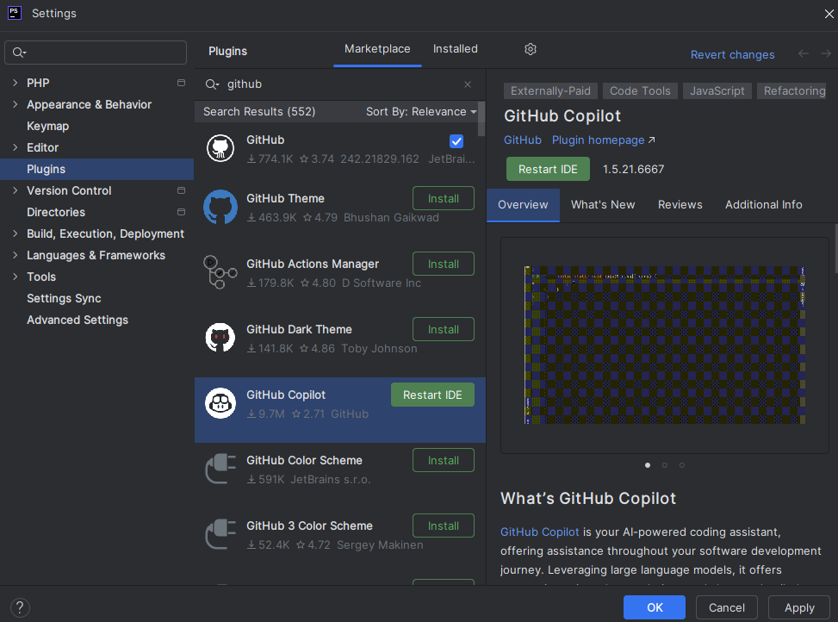
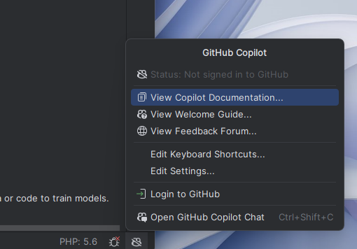
Install CoPilot Plugin

Slide 16


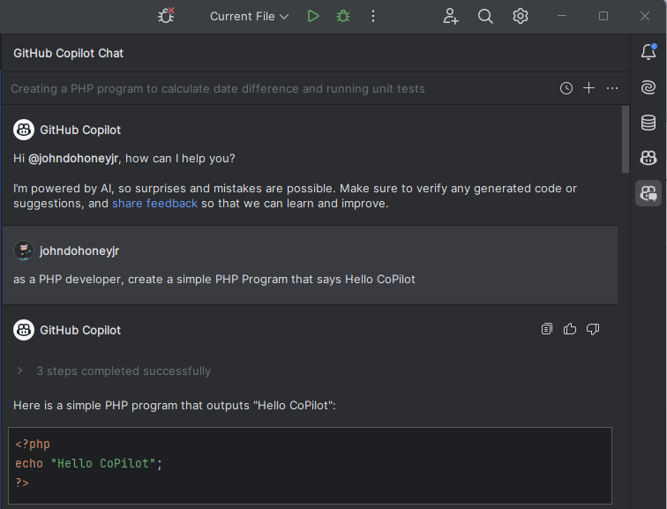
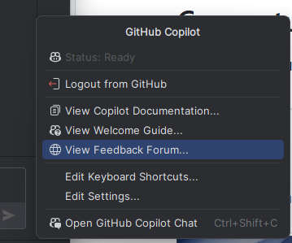

Use CoPilot Chat
Prompt Copilot to perform a development task
Status after Github Login
Activates CoPilot Chat

Slide 17
CoPilot Fast Lane
You can ask CoPilot general programming questions, or chat with the following agents which have specialized expertise and can perform actions:
@workspace - Ask about your workspace
/explain - Explain how the selected code works
/tests - Generate unit tests for the selected code
/fix - Propose a fix for the problems in the selected code
/new - Scaffold code for a new workspace
/newNotebook - Create a new Jupyter Notebook
@vscode - Ask about VS Code
/search - Generate query parameters for workspace search
/api - Ask about VS Code extension development
@terminal - Ask how to do something in the terminal
To have a great conversation, ask CoPilot questions as if it was a real programmer:
Show CoPilot the code you want to talk about by having the files open and selecting the most important lines.
Make refinements by asking the agent follow-up questions, adding clarifications, providing errors, etc.
Review your suggested code and tell copilot about issues or improvements, so I can iterate on it.

